Slide 1
Sharing the usages of
Coding Agent on Machine
Learning Research
Hengli Li 2026.6.7 Opinions are my own.

Slide 2
Who am I?
Supervised by Song-Chun Zhu
PhD Student working on Machine Learning & NLP, with special focus on latent variable modeling and latent reasoning.

Slide 3

I think that collaborating with AI instead of leading them is a better way. You should treat the AI as your collaborator, who you can’t fully trust.

Slide 4
Outline
Brief Introduction of Coding Agent
Starting the research
Pushing forward the research
Helping with paper writing and poster drawing
Using coding agent to help collaborating with others

Slide 5
Part I. Brief Introduction of Coding Agent

Slide 6
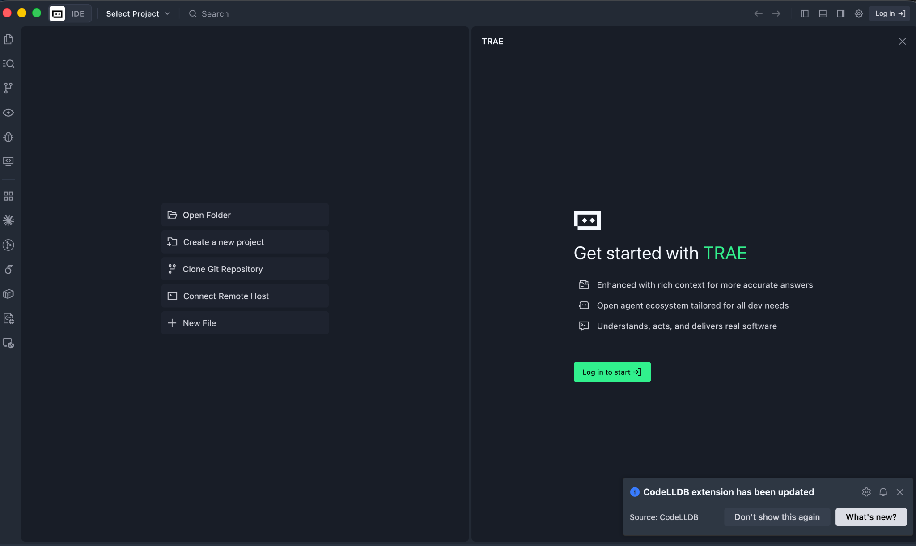
Part I. Brief Introduction of Coding Agent
I have used:
Trae

Slide 7
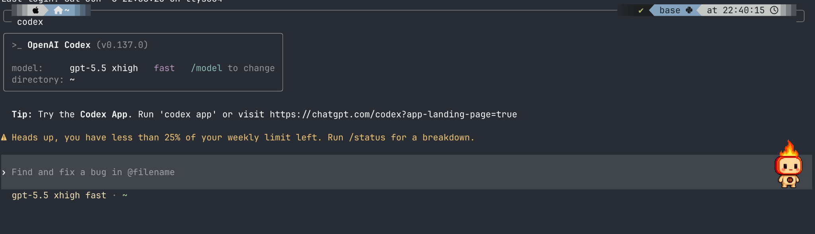
Part I. Brief Introduction of Coding Agent
I have used:
Trae
codex

Slide 8
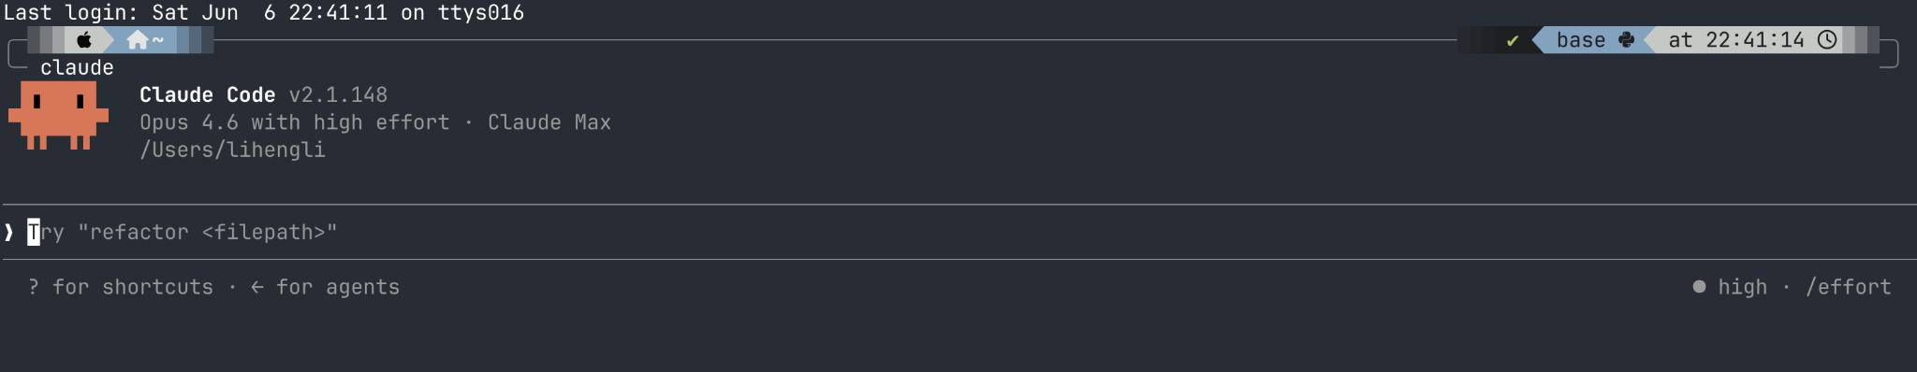
Part I. Brief Introduction of Coding Agent
I have used:
Trae
Codex
Claude code

Slide 9
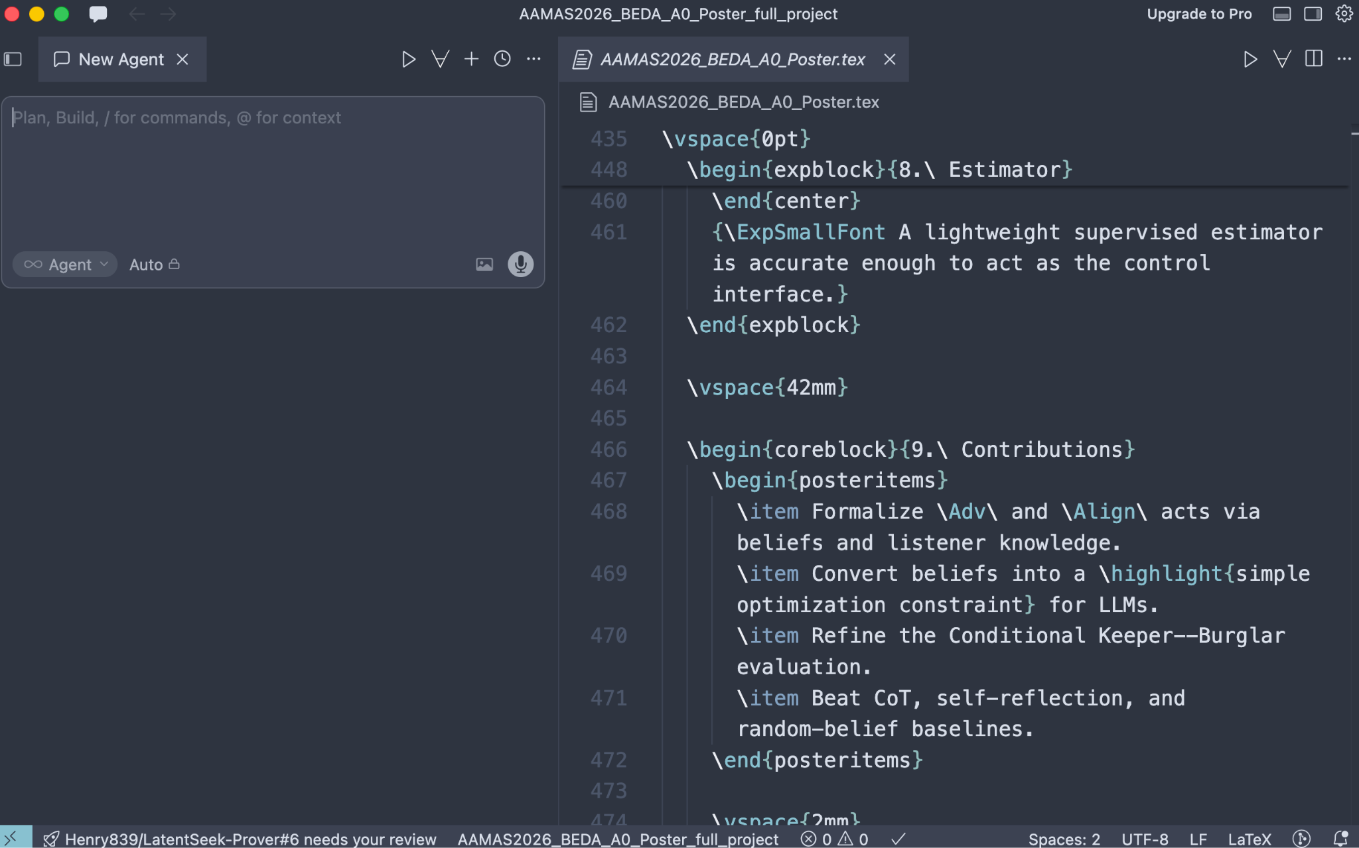
Part I. Brief Introduction of Coding Agent
I have used:
Trae
Codex
Claude code
cursor

Slide 10
Part I. Brief Introduction of Coding Agent
I have used:
Trae (ide based, almost for free, 拉完了，连pdf都读不了）
Codex (cli based, cheap, 夯）
Claude code (cli based, expensive, 夯）
Cursor (ide based, expensive, 顶级）

Slide 11
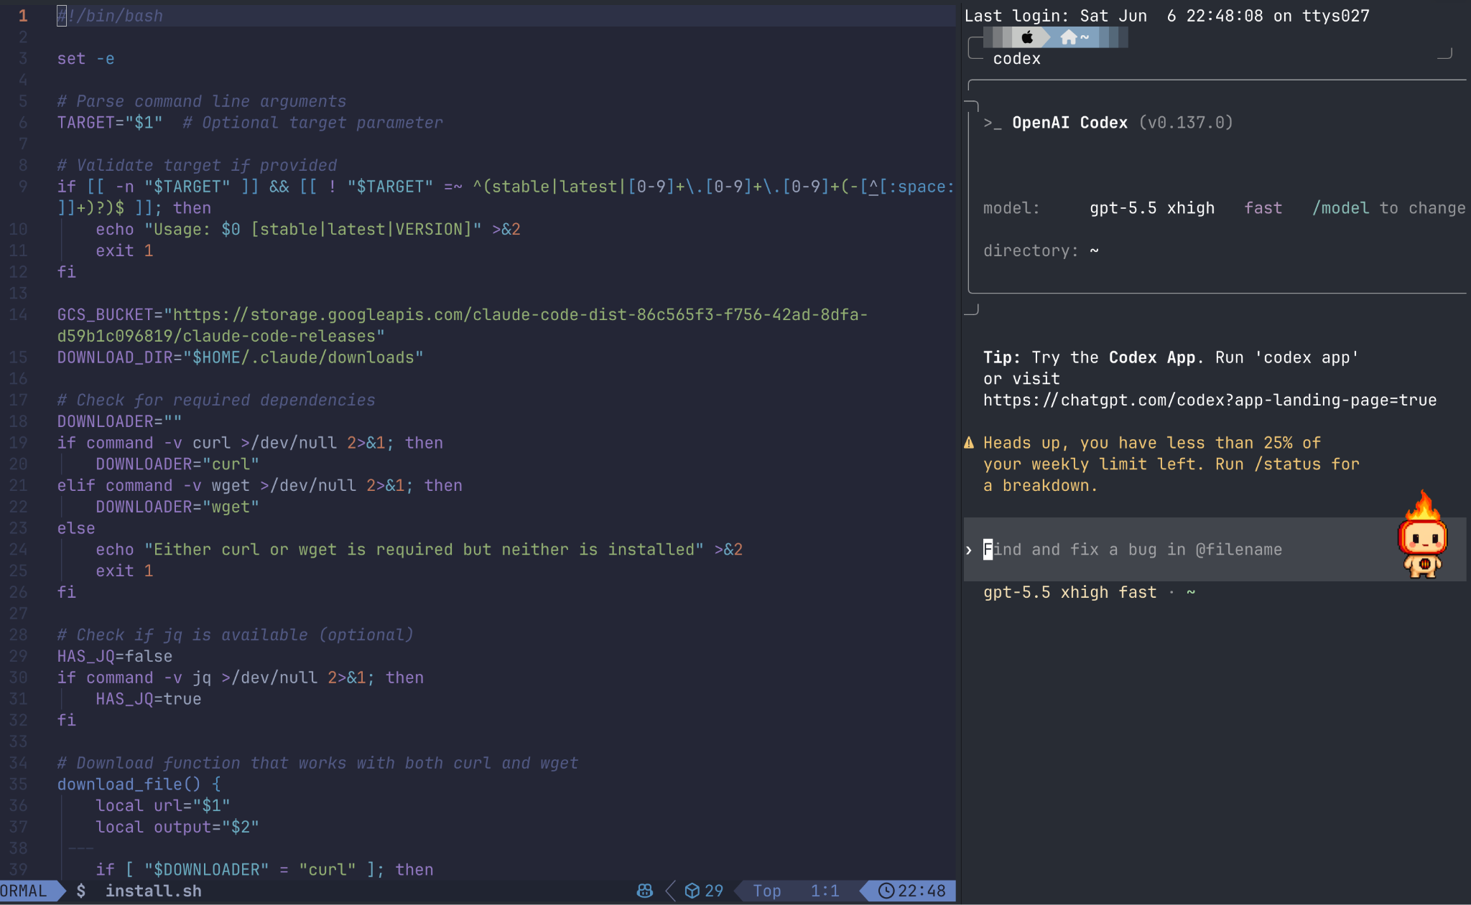
My way of using codex / claude code
I use neovim + Ghosty Terminal for code reading.
With a sidebar for coding agent.

Slide 12
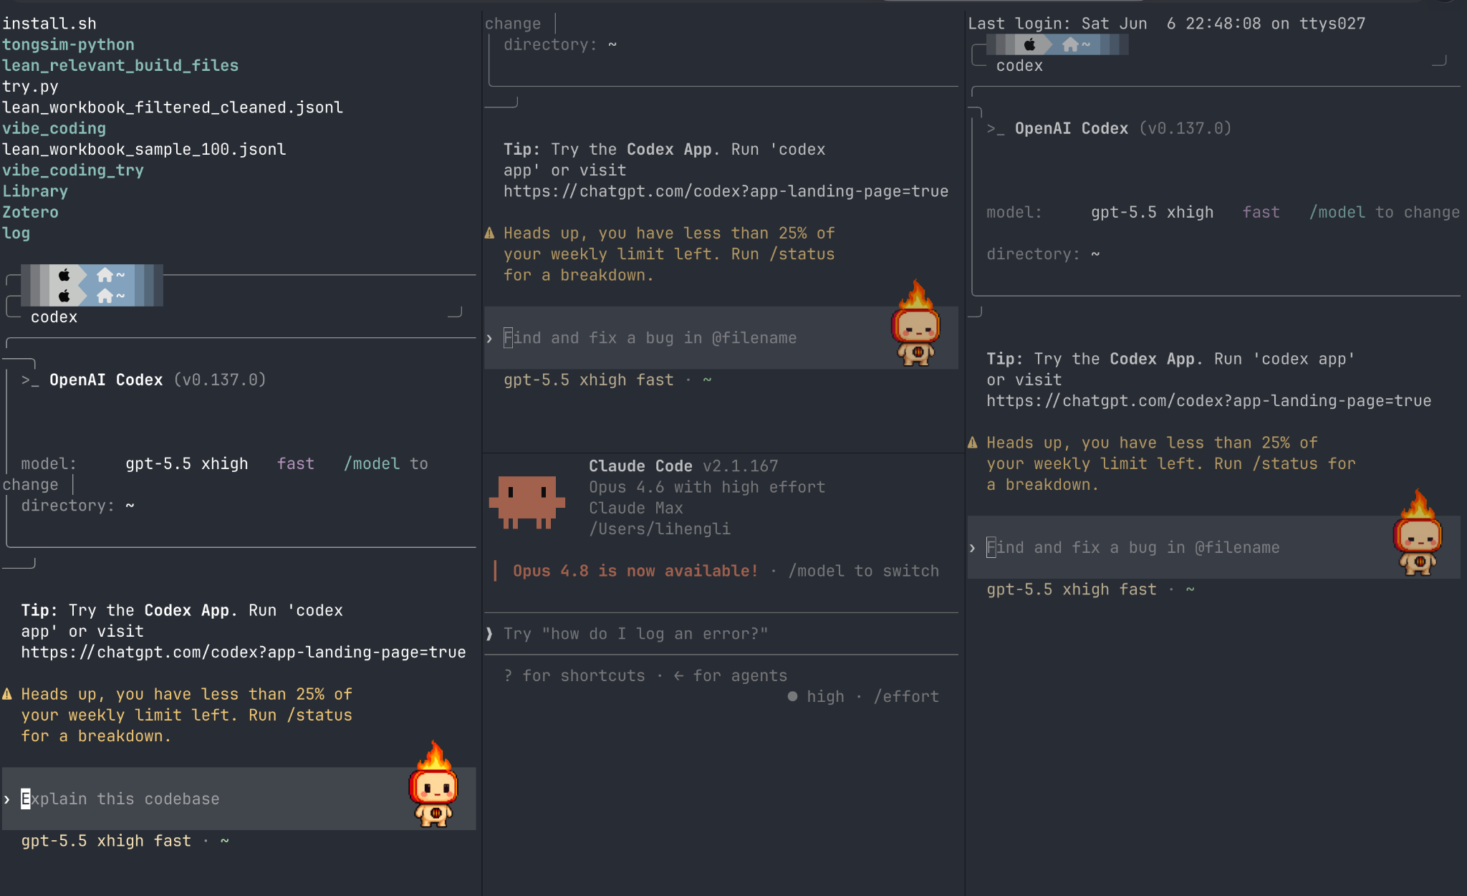
Ghosty Terminal (God in Screen Splitting)

Slide 13
Part II. Starting the Research

Slide 14
Starting a research from scratch
Start with a nice and clear note
My way of writing a note: (1) Motivation. (2) Problem Setup, notations definition. (3) Optimization Objective. (4) Learning Dynamics.

Slide 15
Starting a research from scratch
LLM seems not to be good at concept constructing. It isn’t good at building up views on a problem. Views should be given by humans.
Formulations are a research way of view for ML research.
LLM is good at extending and refining your formulation.

Slide 16
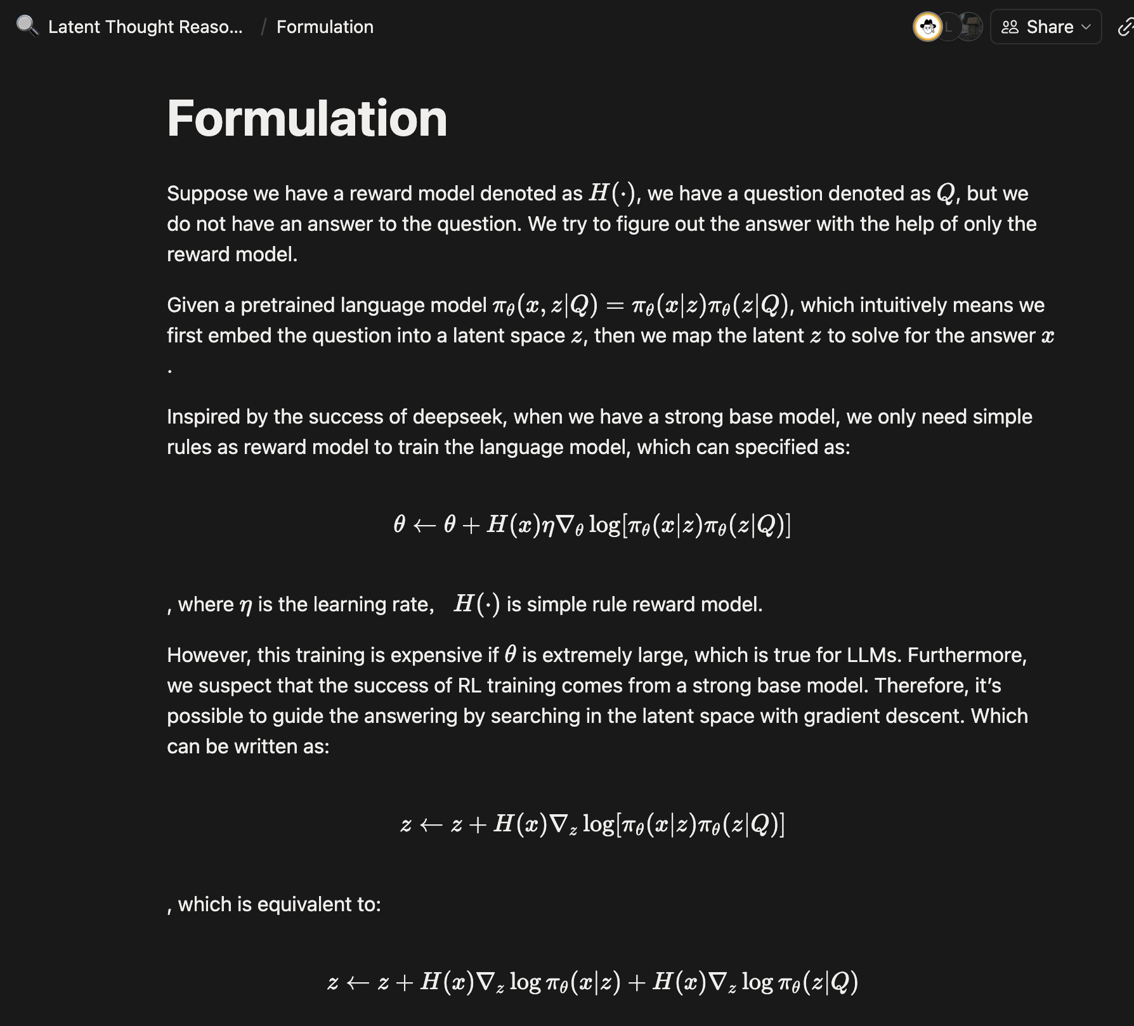
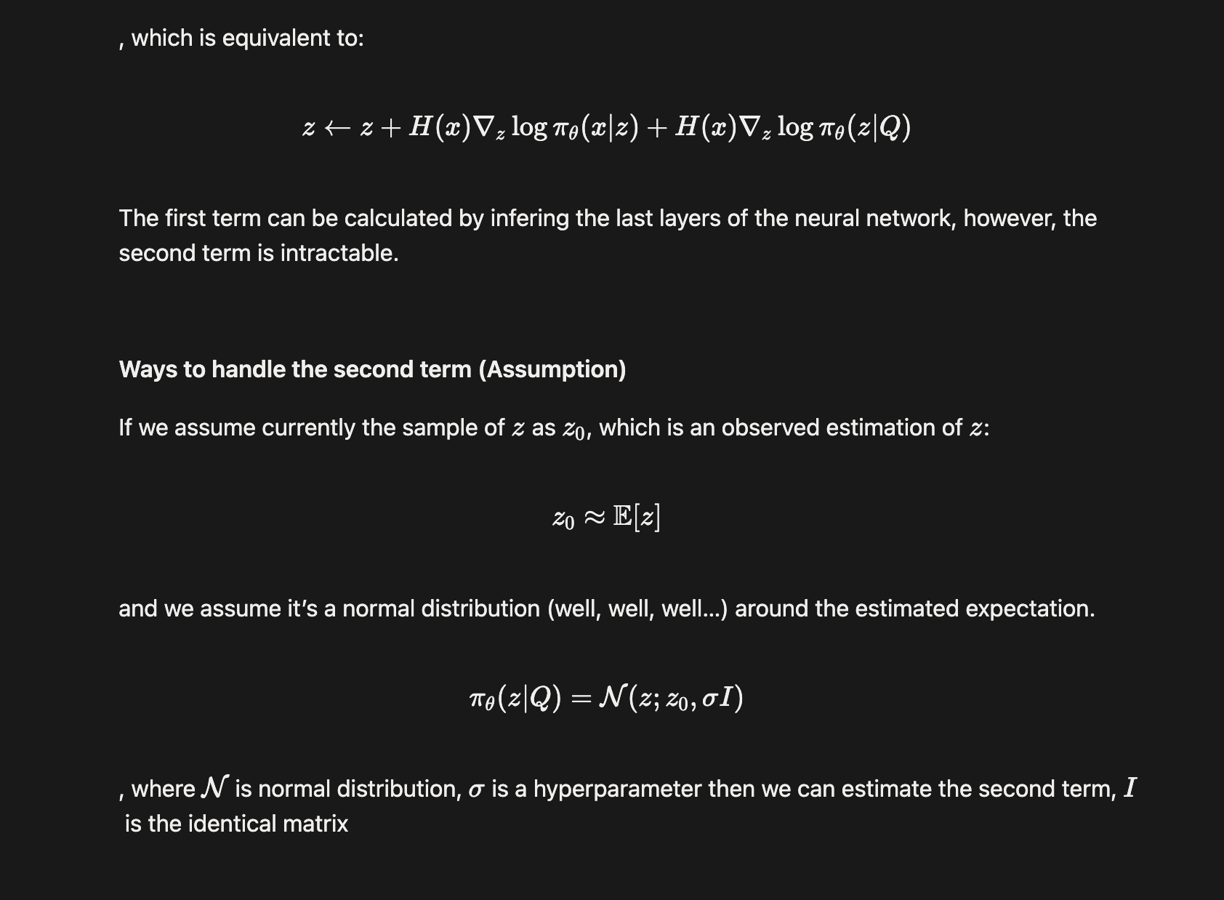
Starting a research from scratch
LLM seems not to be good at concept constructing. It isn’t good at building up views on a problem. Views should be given by humans.
Formulations are a research way of view for ML research.

Slide 17

Starting a research from scratch
With a clear note, discuss with chatgpt for details on the idea.
Are there any related works or similar works? If no, then next step.
Discuss concrete research question.
What backbone model to use?
What dataset to use?
Discuss the codebase setup. How to organize the codebase? Ask gpt to write down a plan file in pdf or markdown.

Slide 18
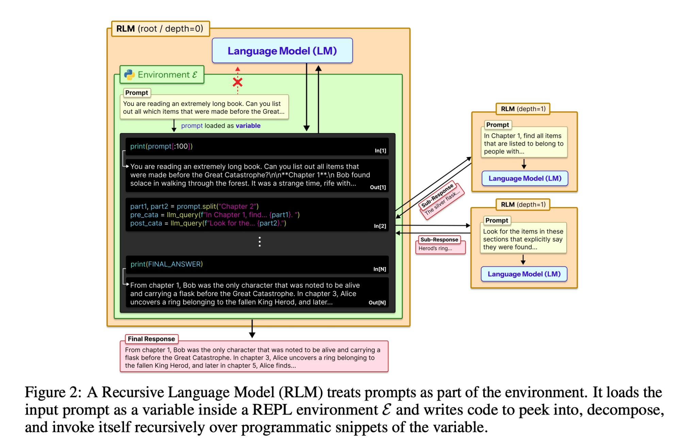
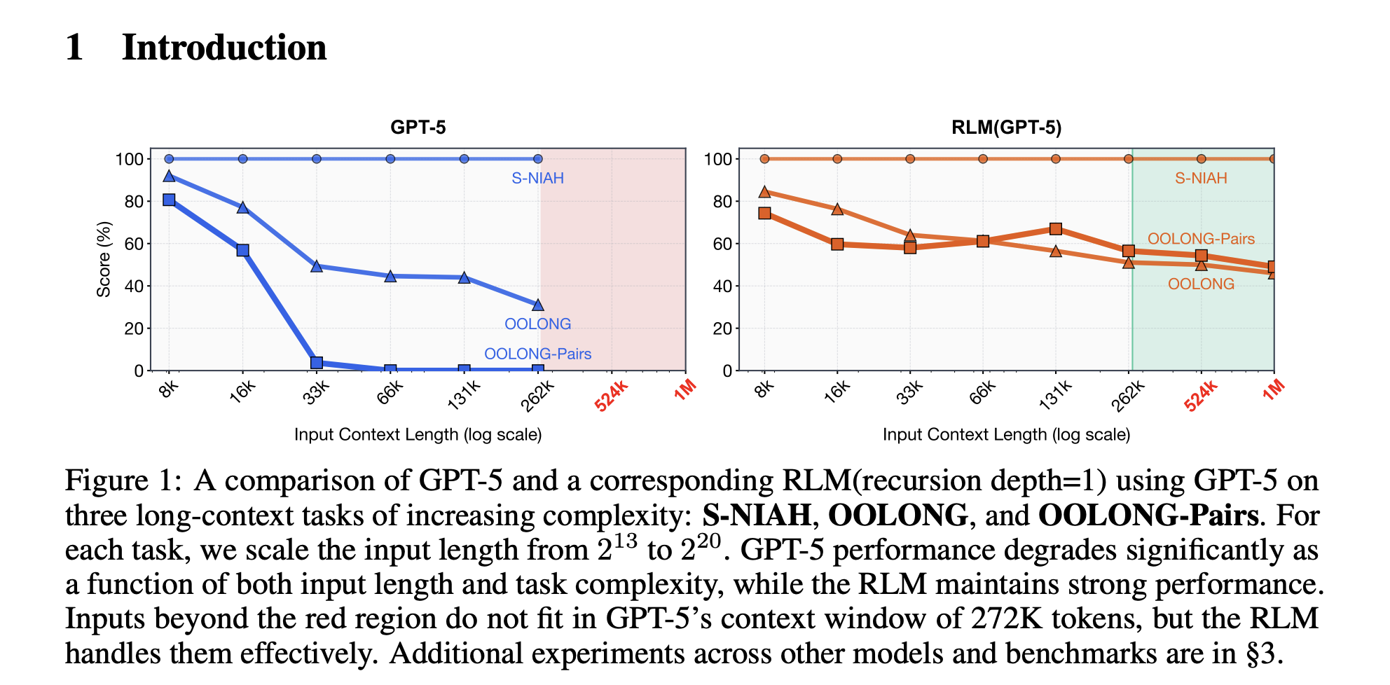
Setup the codebase.
Why markdown or pdf instead of copy the plan to context box?
[1] Recursive Language Models. Zhang et al. 2026.

Slide 19
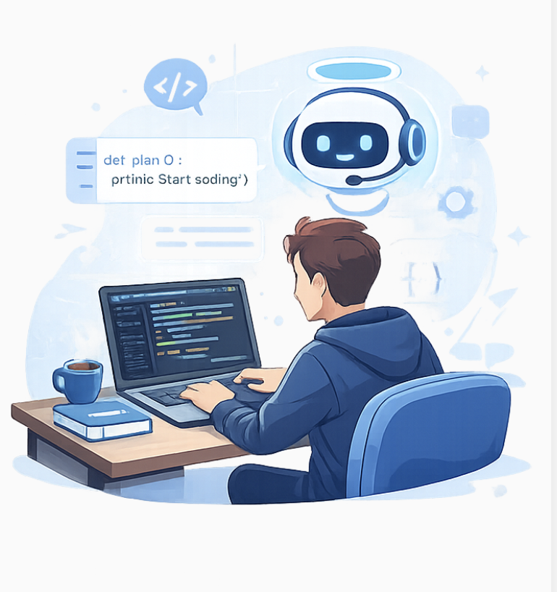
Setup the codebase.
Chat with codex to ensure that it understands every part of your plan.
Start to code!

Slide 20
Part III. Pushing forward the research

Slide 21
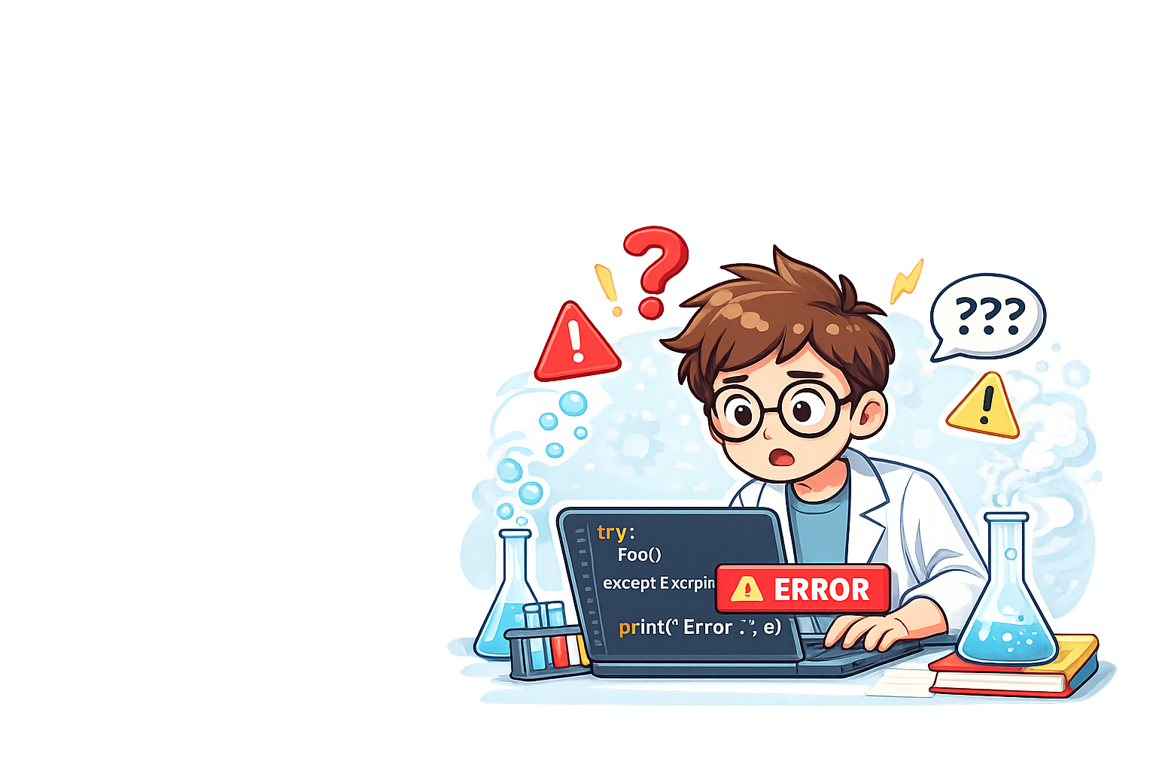
Research Style Coding
Codex tends to write a lot of error handling in code.
However, for research, error handling is dangerous, you don’t know whether they may change your experiments setting implicitly.

Slide 22
Research Style Coding
Codex like to write fallback. ## Research Code Conventions This repository is research code and should be treated as fail-fast by default. Avoid adding defensive error handling, fallback paths, or recovery logic unless they are strictly necessary for correctness, required cleanup, or an external interface that demands explicit handling.

Slide 23
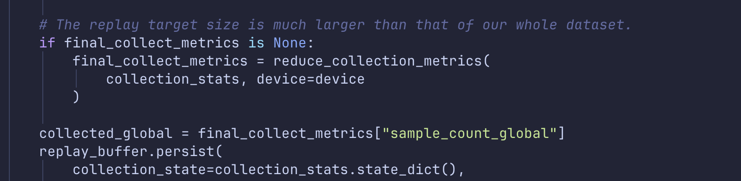
Research Style Coding
Write comment myself. Codex never writes comment, unless being asked to.
This is also my way to get familiar with the code.

Slide 24
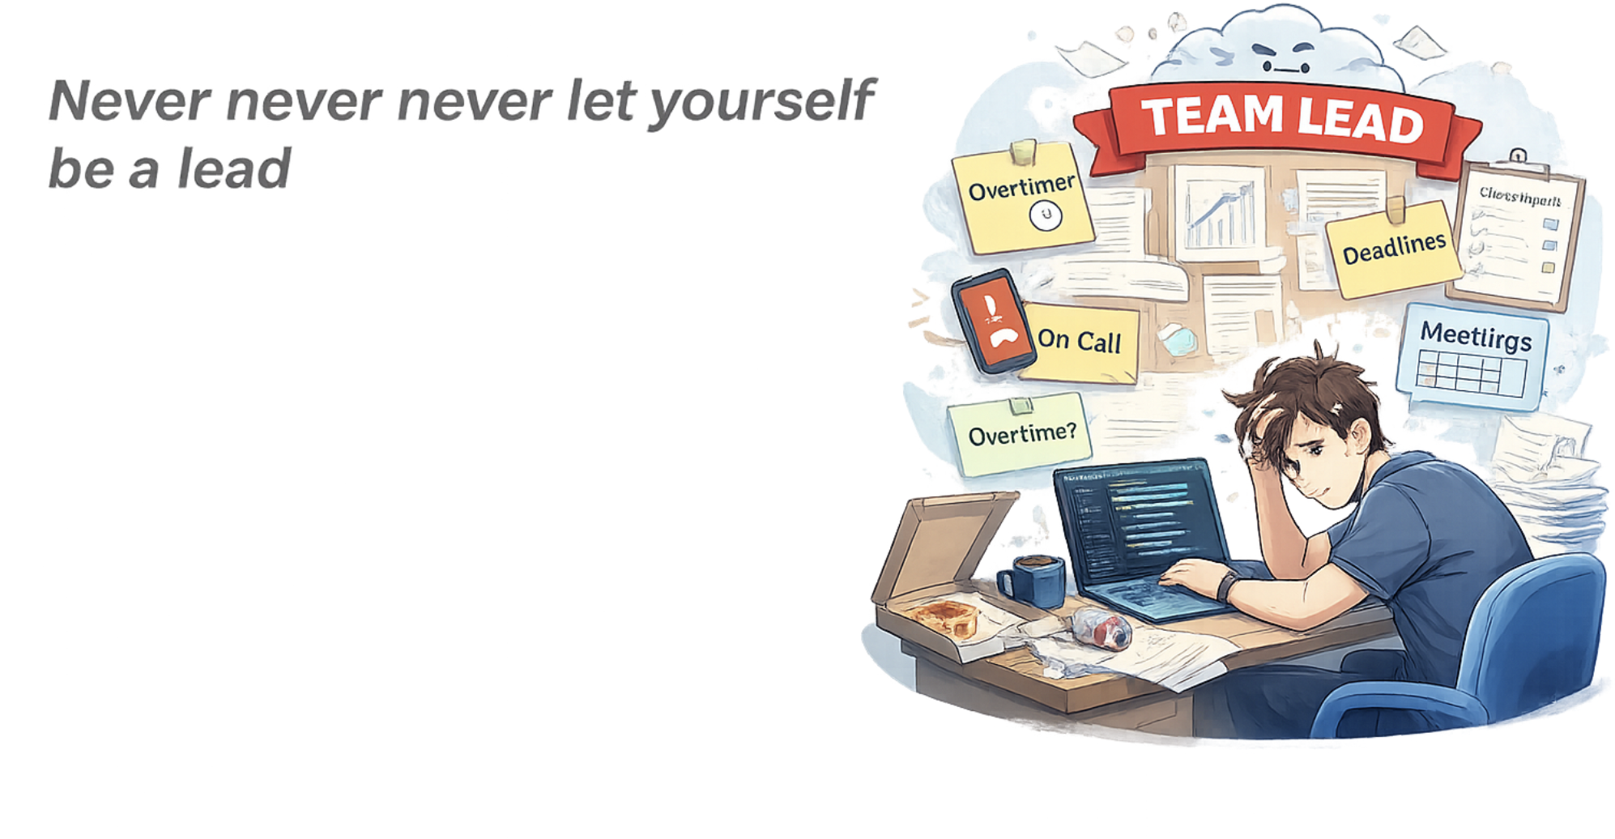

Slide 25
当token用完了

Slide 26
Never never never let yourself be a lead
Don’t lose your identity of being a front line researcher.
Codex doesn’t have embodied feeling, thus it can’t reflect through out the process.
Add comment, clean up code and tidy up stuffs by yourself.

Slide 27
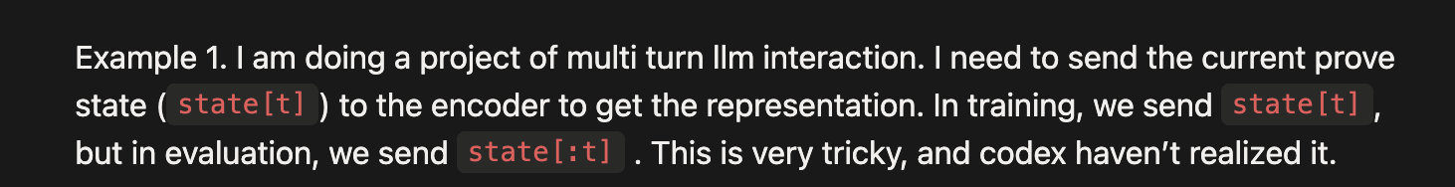
Don’t lose your identity of being a front line researcher.
This is what I experienced at the beginning of vibe coding. I hand everything to AI. This results in a problem for ml method research (you don’t know where to go and you have no “embodied” feedback).
Codex isn’t as smart as you think. You should be extremely familiar with the code. There may be very small bugs:

Slide 28

Codex doesn’t have embodied feeling, thus it can’t reflect through out the process.
A great advantage of front line researcher in the ML field is their interaction with the algorithm.

Slide 29
Codex doesn’t have embodied feeling, thus it can’t reflect through out the process.
LLM is a passive machine, it won’t start to reflect unless you tell it to.
Every ML researcher has a model or some hypothesis on the to-be-run experiments, and we map the output with our model from time to time.
However, codex doesn’t have this, it just keep doing jobs, without realizing that something deep in math or algorithm is wrong.

Slide 30
Add comment, clean up code and tidy up stuffs by yourself.
Through the process of tidying, you get a deeper understanding of your code and you can have “embodied experience”.
My experience on verl.
Saining Xie:”if your project is always the same as your designation at the beginning, then it’s a total failure”

Slide 31
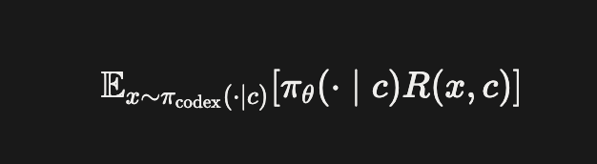
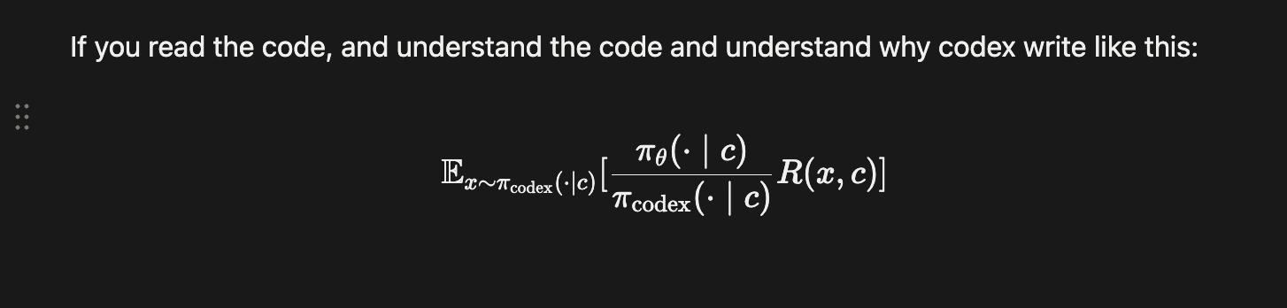
Don’t let codex write code that you don’t understand.

Slide 32


Slide 33
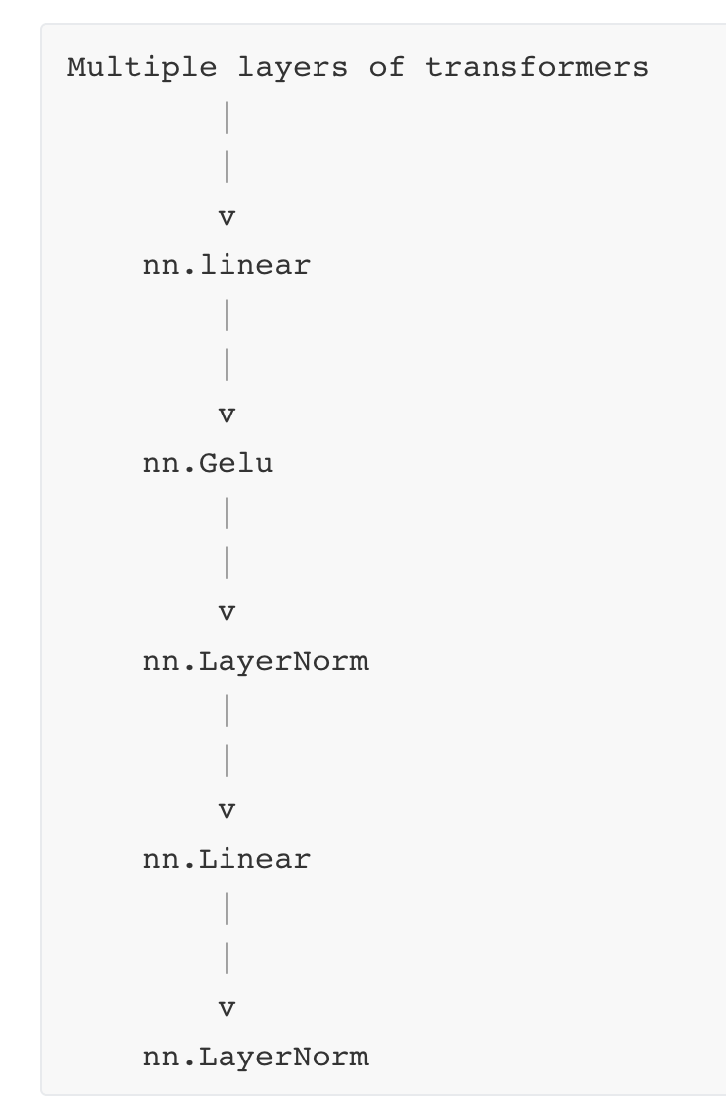
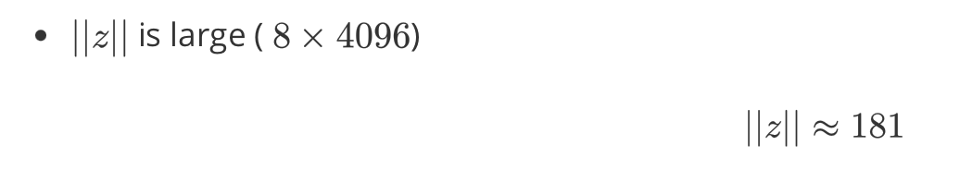
Numerical Sensitivity
Encoder on the right.
Transformers (Qwen), others random init
The output of the encoder is always
Why 181? Guess?

Slide 34
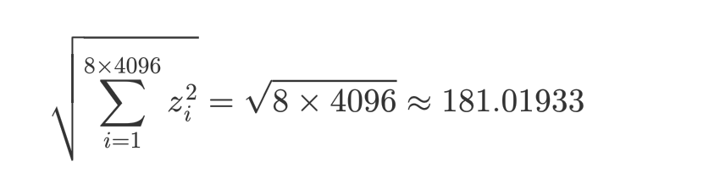
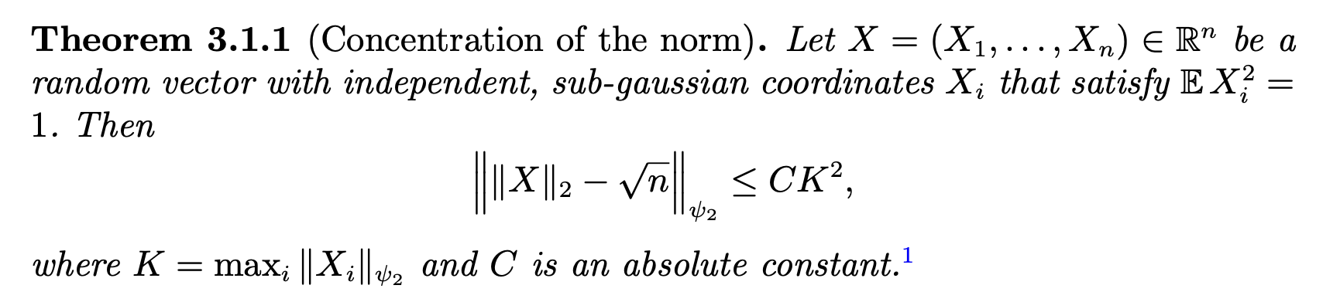
Numerical Sensitivity

Slide 35
Quick Reading Ability
Claude code and codex are fast code readers, they can quickly grab every small part of the code to obtain a full view of function of each code block.
You can use it as a code reader helper.
Ask it to tell you why we need this function?

Slide 36
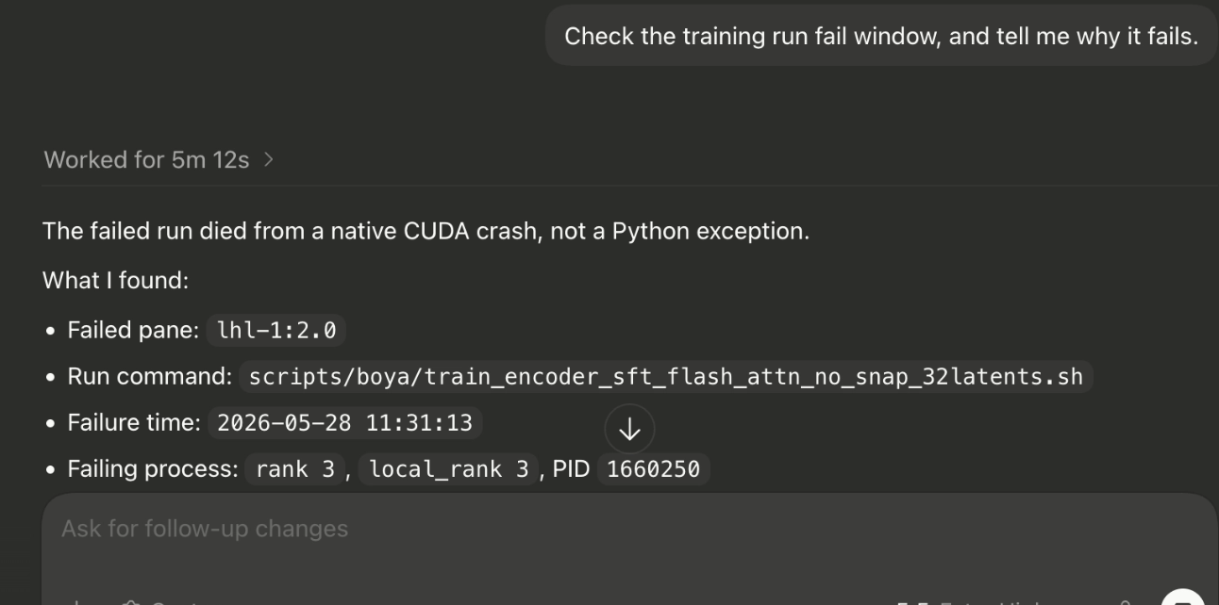
Ability to handle problems of virtual environment

Slide 37
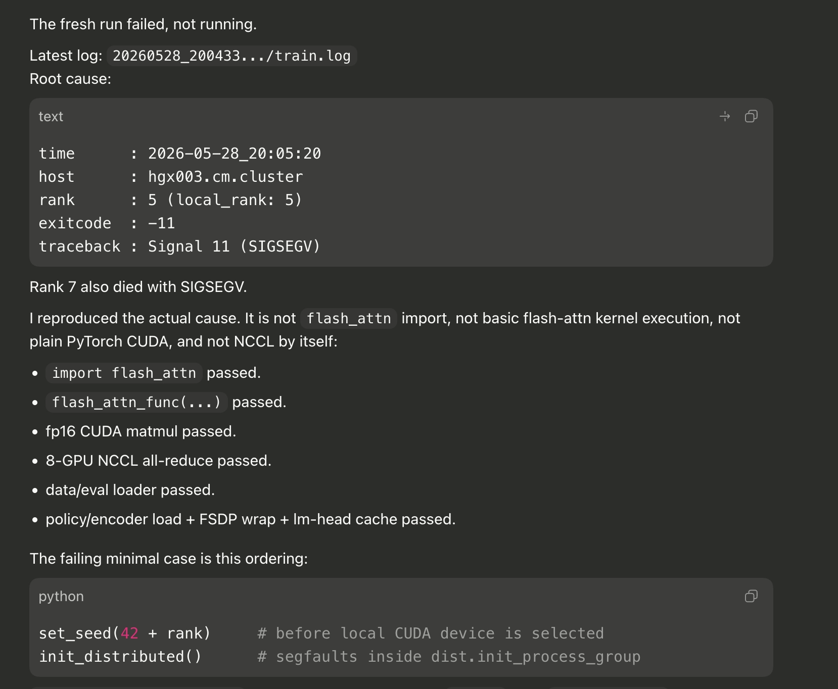

Slide 38
Ssh modification trick
You can also ask coding agent to ssh to a server. And modify the code through ssh.
Hard for human, but easy for LLM.

Slide 39
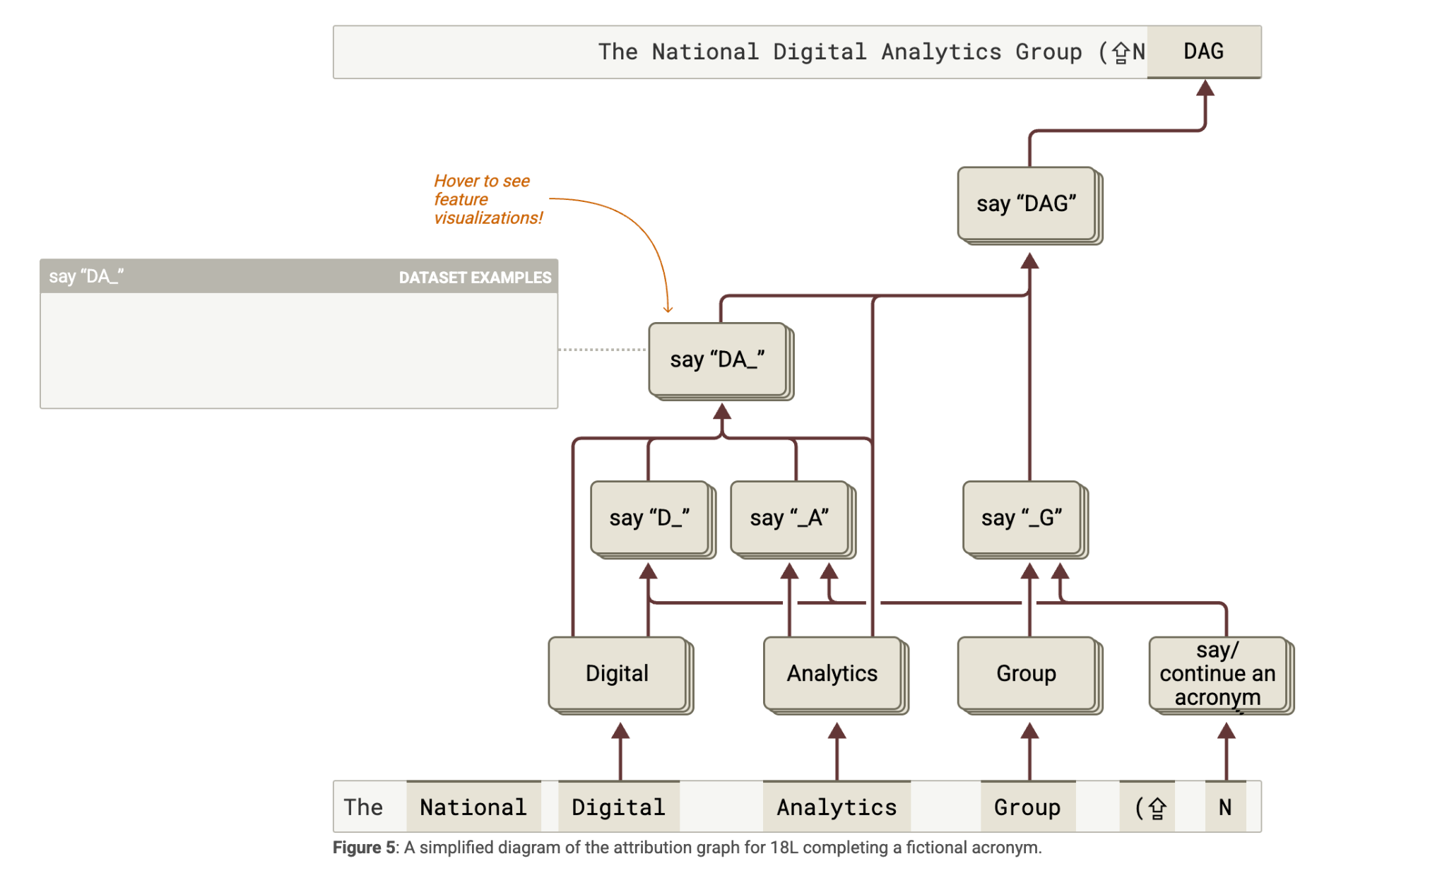
[1] Circuit Tracing: Revealing Computational Graphs in Language Models. Anthropic Team. 2025.

Slide 40
Part III. Helping with paper writing and poster drawing

Slide 41
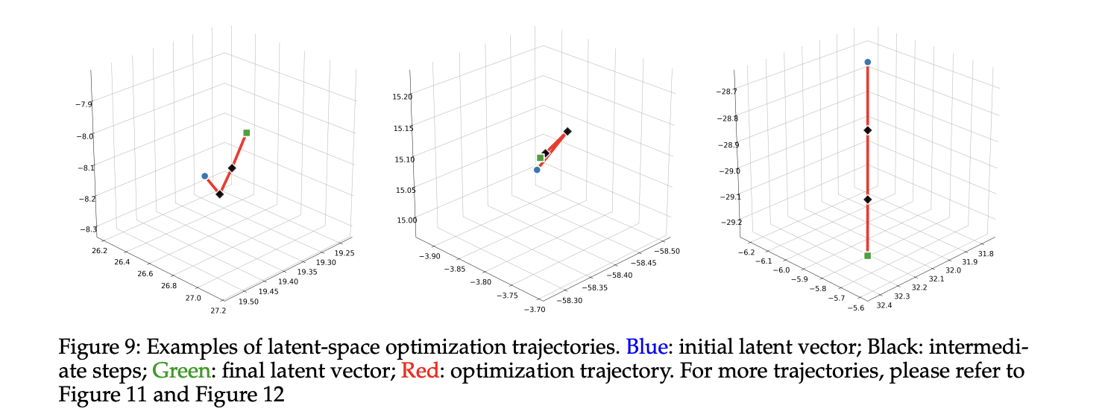
Result analysis

Slide 42
Polishing words, and checking references
Paper writing.
Checking bibtex (GPT 5 Pro)

Slide 43
Trick on Paper Reviewing
Finding prompt injection (ICML)

Slide 44
Part III. Poster Drawing

Slide 45
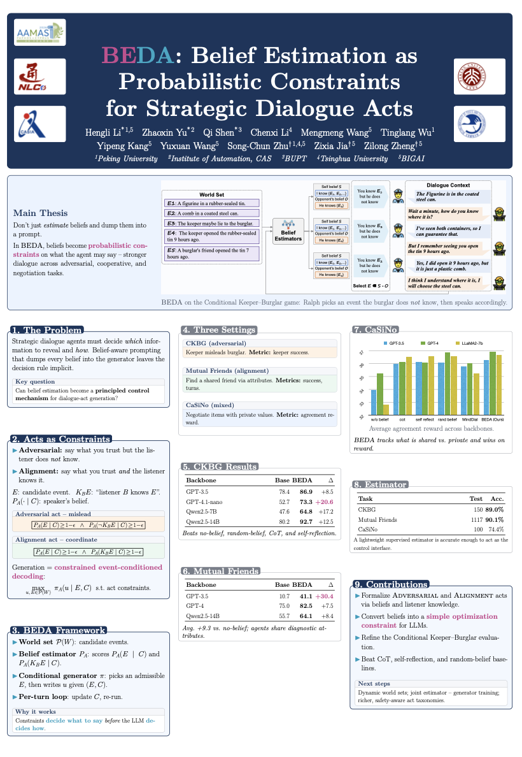
Use Claude Cowork for design task.
Claude is better at designation.

Slide 46
I think that collaborating with AI instead of leading them is a better way. You should treat the AI as your collaborator, who you can’t fully trust.

